Slide 1
Goals, objectives, and performance metrics
Allan Hicks
MSAB012
October 2018

Slide 2
MSAB-011 Report: Goals and objectives
18 The MSAB REQUESTED that the IPHC Secretariat standardize the terminology for types of objectives
20 The MSAB REQUESTED that the objectives … be refined by an Ad-Hoc Working Group
26 The MSAB AGREED that some of the measurable objectives related to Fishery Sustainability, Stability, and Access are redundant and should be considered by the Ad-Hoc Working Group
27 The MSAB NOTED that the following subset of measurable objectives related to Fishery Sustainability, Stability, and Access of the coastwide stock may be sufficient:
to maintain a minimum catch;
maintain an average catch;
provide opportunity for above average catches; and
limit annual changes in TAC, coast-wide and/or by IPHC Regulatory Area.

Slide 3
MSAB011 Report: objectives
28 The MSAB REQUESTED that the IPHC Secretariat continue to discuss the Biological Sustainability (conservation) objectives with the IPHCs Scientific Review Board (SRB)…
SRB013_R, para 25 The SRB NOTED that the current IPHC MSE goals and objectives are useful to evaluate harvest strategies using the three primary performance metrics and additional statistics of interest. Further refinements to the fishery related objectives may be made at MSAB012, and reported to the SRB for review.
SRB012-R, para 29: The SRB AGREED that the following proposed Biological Sustainability objectives are consistent with standard practice:
1.1 is retained with a biomass limit of 20% SB0 and a probability of ≤10%;
1.2 is probably not necessary since the target is a result of applying the harvest control rule;
Median average relative spawning biomass is also presented;
and the usefulness of these metrics be re-evaluated once the MSE is operational

Slide 4
MSAB011 Report: objectives
29 The MSAB AGREED that the goal “Serve Consumer Needs” is captured under the goal of Fishery Sustainability and Stability, and is not needed.
34 The MSAB AGREED that the Commission should review and provide guidance on the revised goals, objectives, and performance metrics at AM095
37 The MSAB AGREED that objectives should be hierarchical and if Biological Sustainability objectives are not met by a management procedure, additional objectives are not evaluated

Slide 5
Goals
Biological sustainability
Maximize (optimize?) directed fishing opportunities
Minimize discard mortality
Minimize bycatch and bycatch mortality

Slide 6
Ad-hoc objectives working group
Peggy Parker, Michelle Culver, Chris Sporer, Dan Falvey
Allan Hicks, Steve Keith
Met on June 26 via telephone and subsequently over email
Identify main objectives
Phrase objectives in a useful manner
Identify a priority to objectives

Slide 7
Objectives (definitions)
General Objective: higher level, broad, aspirational
Measurable Objective: more specific, can be measured
Measurable Outcome: specifically what is to be achieved
Time-frame: period want to achieve outcome, number of years to measure the outcome
Tolerance: the risk willing to take
Performance Metric: the metric determined from the above
Statistic of interest: a metric determined that does not have a specific tolerance defined. Typically secondary in evaluation

Slide 8
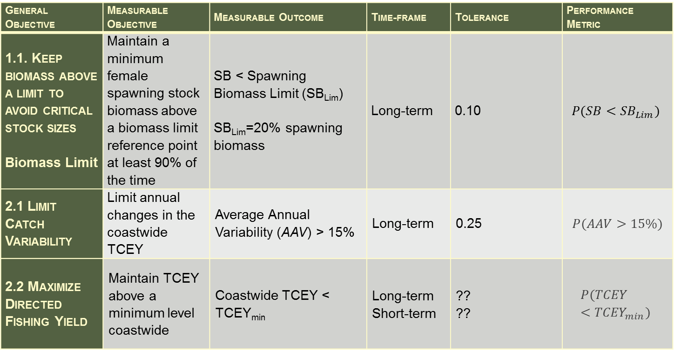
Current Goals and Objectives (primary)
General Objective | Measurable Objective | Measurable Outcome | Time-frame | Tolerance | Performance Metric
1.1. Keep biomass above a limit to avoid critical stock sizes Biomass Limit | Maintain a minimum female spawning stock biomass above a biomass limit reference point at least 90% of the time | SB < Spawning Biomass Limit (SB_{Lim}) SB_{Lim}=20% spawning biomass | Long-term | 0.10 | $$P(SB<{SB}_{Lim})$$
2.1 Limit Catch Variability | Limit annual changes in the coastwide TCEY | Average Annual Variability (AAV) > 15% | Long-term | 0.25 | $$P(AAV>15\%)$$
2.2 Maximize Directed Fishing Yield | Maintain TCEY above a minimum level coastwide | Coastwide TCEY < TCEY_{min} | Long-term Short-term | ?? ?? | $$P(TCEY<{TCEY}_{min})$$

Slide 9
Priority
Must meet Biological Sustainability (1.1)
Then meet catch limit stability (2.1) and maintain a minimum catch limit (2.2)
Then, maximize catch limit subject to above
Statistics of interest can be informative and benefit the evaluation

Slide 10
Biological sustainability
Only one conservation objective needs to be met
Avoiding stock sizes that may cause irreproducible harm
Limit biomass (20% dynamic relative spawning biomass)
Target biomass is determined by F_{SPR} (and other parts of MP)
Additional conservation objectives could be added
Often they are better defined as fishery objectives
Maintain a high (target) biomass to keep catch-rate high can be defined as a fishery objective related to catch rates
Statistics of interest are also informative
The median biomass realized
The number of mature females

Slide 11
Optimize directed fishing opportunities
Optimize may be more consistent with the Convention
To develop the stocks of Pacific halibut in the Convention waters to those levels which will permit the optimum yield from the fishery and to maintain the stocks at those levels
Stability objectives are listed first but are not meant to have priority over yield objectives.

Slide 12
Discard mortality & Bycatch mortality
Not discussed by the ad hoc working group
Retained for future consideration

Slide 13
Statistics of interest
Other metrics that are not defined as a specific performance metric with a risk tolerance
Median long-term TCEY
AAV
Probability stock status is less than 30%
AAV while on the ramp
Probability TCEY is less than 46 Mlbs
Range of TCEY (5th and 75th percentiles
See document IPHC-2018-MSAB012-06 for Tables

Slide 14
Commission Recommendations
AM094-R, para 36. The Commission RECOMMENDED that the draft goals, objectives, and performance metrics, as detailed in Appendix IV, IPHC-2017-MSAB10-R be used for ongoing evaluation in the MSE process, and that they may be refined in the future. The objectives should be evaluated in a hierarchal manner, with conservation as the first priority.
… noting SRB11–Rec.02 to develop an objectives hierarchy, the MSAB is requested to evaluate management procedure performance against objectives that prioritize long-term conservation over short-/medium-term (e.g., 3-8 years) catch performance. Where helpful in accelerating progress on scale, the MSAB is requested to constrain objectives to (1) maintain biomass above a limit to avoid critical stock sizes, (2) maintain a minimum average catch, and (3) limit catch variability

Slide 15
MSAB011 Report: Time-periods
39: The MSAB AGREED to consider long-term metrics related to Biological Sustainability objectives and short- and long-term metrics related to fishery objectives when evaluating management procedures …
40: The MSAB REQUESTED that the IPHC Secretariat determine methods to present qualitative results describing the transition from the short-term to the long-term for various performance metrics as a way to describe medium-term performance.
41: The MSAB REQUESTED that the IPHC Secretariat present the methods for producing short-, medium- and long-term results to the SRB for their review and comment

Slide 16
SRB Review
SRB013-R, para 26: The SRB REQUESTED that the MSAB consider listing prioritized objectives used to guide the selection of a management procedure. These could include any combination of short, medium, and long-term objectives, provided Commission objectives be given highest priority. All performance metrics in the MSE must be computed from the operating model. See paragraph 30 for further clarification.

Slide 17
SRB Review
SRB013-R, para 30: The SRB RECOMMENDED a clear separation between the current stock assessment process and MSE process, so that it is understood:
these two processes, including statistics and performance metrics, are distinct and not comparable;
the purpose of the current ensemble stock assessment approach is to develop a decision table to assist the Commission in setting an annual TCEY. This TCEY setting process lacks specificity and how decisions are made is unclear. Furthermore, repeated application of this process is difficult to evaluate relative to Commission objectives;
the purpose of the MSE is to compare alternative management procedures against Commission objectives over a wide range of plausible uncertainties within the operating model and management procedures. Therefore, these procedures by definition must be specific and repeatable.

Slide 18
Reporting time periods
Performance metrics from the MSE are meant to rank the management procedures, not predict
The three objectives (conservation risk, stability, maximize catch) are very amenable to ranking MPs
Others (e.g., prob TCEY > X) is more of a prediction, but can still be used to rank MPs

Slide 19
Appropriate time periods
Conservation
Long-term is priority
Avoid MPs that may result in high short-, medium-term risk or determine a phase-in period
Stability
Long-term is important
Short-term is also important as stock/fishery transition to long-term
Yield
All time periods are important
It somewhat depends on where the stock is now

Slide 20
Primary performance metrics
Performance metric | Description
P(SB < SB_{Lim}) | Times out of 100 that the relative spawning biomass (status) is below the limit. The limit is defined as 20% of the spawning biomass if no fishing had occurred.
P(AAV > 15%) | Times out of 100 that the average annual variability (AAV) is greater than 15%. AAV can be thought of as the average change in the Total Mortality limit from year to year.
Median TM | Median coastwide TM. The TM is greater than this value in half of the simulations.

Slide 21
Some secondary performance metrics
Statistic of interest | Description
Median SB | The median biomass expected in the long-term
Median # females | The median number of females expected in the long term.
AAV | The Average Annual Variability, which can be thought of as the average change in the TM from year to year
P(↓TM > 15%) | Times out of 100 that the TM decreases by more than 15% compared to the previous year.
AAV|SB<SB_{Trig} | The average annual variability when the stock status is below the fishery trigger (often referred to as ‘on the ramp’).
$$P\left(\hat{SB}<{SB}_{Trig}\right)$$ | Times out of 100 that the estimated spawning biomass (status) is less than the fishery trigger, thus invoking ‘the ramp’ and reducing fishing intensity.
P(TM < TM_{min}) | Times out of 100 that the Total Mortality limit would be set below a minimum value. The minimum TM has not been determined, and is currently an ad hoc value of 34 Mlbs, which is the minimum Total Mortality observed (TM) since 1906.
P(TM < 54) | Times out of 100 that the TMq is less than 54 Mlbs, which is 70% of the average TM from 1993 to 2012.
5th & 75th TM | The 5th and 75th percentiles of the Total Mortality limit from the simulations. This means that 5 out of 100 are less than or equal the 5th percentile and 25 out of 100 are greater than or equal to the 75th percentile.

Slide 22
Two types of probabilities
P(all …): the probability of that event over all simulations. In other words, what is the probability that this event would occur in a given year.
P(any …): the probability of that event occurring in 1 or more years over the defined period
Note that this probability increases as the period increases

Slide 23
Presentation of performance metrics
Control Rule | 30:20 | 30:20 | 30:20
SPR | 30% | 40% | 46%
Est Error | 0.15 | 0.15 | 0.15
Autocorrelation | 0.4 | 0.4 | 0.4
P(all SB < 20%)
P(any SB < 20%)
P(all AAV > 15%)
Median TM
Median SB
P(all SB < 30%)
AAV
P(all ↓TM > 15%)
P(all TM < 34)
5th & 75th TM
Primary
Statistics of interest

Slide 24
Biological Sustainability Metrics
Median average SPR
Median average dRSB
5th% average dRSB
95th% average dRSB
Median average # mature females
P(all dRSB<20%)
P(any dRSB_y<20%)
P(all dRSB<25%)
P(any dRSB_y<25%)
P(all dRSB<30%)
P(any dRSB_y<30%)
P(all dRSB<40%)
P(any dRSB_y<40%)
P(increase SB|dRSB 20-30%)

Slide 25
Fishery Sustainability Metrics
P(all Comm=0)
P(any Comm=0)
P(all Directed < 50.6 Mlbs)
P(any Directed < 50.6 Mlbs)
P(all decrease TM > 15%)
P(any decrease TM > 15%)
median AAV TM
median AAV Directed
median AAV Commercial
5th% AAV TM
95th% AAV TM
P(all AAV > 15%)
P(all TM < 34 Mlbs)
P(any TM < 34 Mlbs)
Median average TM
Median average Directed
Median average Commercial
5th% average TM, Direct, & Commercial
75th% average TM, Direct, & Commercial
95th% average TM, Direct, & Commercial

Slide 26
Requests
NOTE paper IPHC-2018-MSAB012-06
CONSIDER the refined MSAB goals, measurable objectives and associated performance metrics, and the prioritizing of conservation objectives.
CONSIDER the statistics of interest to supplement the evaluation of management procedures.
CONSIDER the objectives identified by the US Commissioners at IM093 for distributing the TCEY.
RECOMMEND goals and objectives for evaluation of the Scale component of the harvest strategy policy.
RECOMMEND a practical set of performance metrics, including statistic of interest, to report for the evaluation of [these and] future simulations[, including time-periods of interest].
SUGGEST methods (e.g. tables and figures) to report the performance metrics listed here for the evaluation of [these and] future results from the simulations.

Slide 27
What we need for evaluations this week
Are there any specific performance metrics that you would like to see this week?
What time-periods would you like to see this week?
Long-term (final 10 years of simulation) will be reported
Others?
Let me know what else as we will learn more

